Slide 1











TEKNIK PENULISAN & PENERBITAN ARTIKEL ILMIAH INTERNASIONAL
dede.kardaya@unida.ac.id
Notes:
NOTE:
To change the image on this slide, select the picture and delete it. Then click the Pictures icon in the placeholder to insert your own image.

Slide 2
CONTENT
OVERVIEW OF SCIENTIFIC PUBLISHING
TITLE
BYLINE
ABSTRACT
KEYWORDS
INTRODUCTION
METHODS
RESULTS
DISCUSSION & CONCLUSIONS
ACKNOWLEDGEMENT
REFERENCES
SUBMITTING MANUSCRIPTS

Slide 3






1. OVERVIEW OF SCIENTIFIC PUBLISHING
RESEARCH
PUBLICATION
CREDIT/GRADUATION
SCIENTIST
REGISTER INVENTION
RESEARCH QUALITY STAMPED
COLLABORATION
RECOGNITION
WHY DO WE PUBLISH?

Slide 4
FROM RESEARCH PROPOSAL TO ARTICLE
RESEARCH PROPOSAL
TITLE/TOPIC
THESIS/REPORT
TITLE/TOPIC
ARTICLE
TITLE
ABSTRACT
SUMMARY
RESEARCH QUESTION, GOAL
USEFULNESS
LITERATURE REVIEW
METHOD
REFFERENCES
BUDGET
BIODATA
ABSTRACT
INTRODUCTION
INTRODUCTION
METHODS
METHODS
RESULTS
RESULTS
DISCUSSIONS
DISCUSSIONS
REFFERENCES
CONCLUSION & RECOMENDATION
CONCLUSION & IMPLICATION
REFFERENCES
APPENDIX
ACKNOWLEDGEMENT
SUPPLEMENTARY MATERIALS

Slide 5
2. TITLE:What is the paper broadly about?
Your opportunity to attract the reader’s attention.
Reviewers will check whether the title is specific and whether it reflects the content of the manuscript.
Avoid titles that make no sense or fail to represent the subject matter adequately;
Keep it informative and concise;
Avoid technical jargon and abbreviations if possible.
Discuss with your co-authors.
The fewest possible words that adequately indicate the contents of the paper
Important in literature searching
Should not include extra words, such as “A Study of” or “Observations on”
Should be specific enough
Running title: short version of title—appears at tops of pages

Slide 6
2. TITLE: How can we generate a title?
Think about the following questions:
What have I found that will attract attention?
What is new, different and interesting about my findings?
What are the 3–5 key words that highlight what makes my research and my findings unique?
On the basis of your answers you should be able to formulate a title.

Slide 7
3. BYLINE:
Indicates: authorship and ownership
Consists: author(s) name and institution(s)
Copyright holder of an articles is the journal where it is published
Those with important intellectual contributions to the work
Often listed from greatest contributions to least
In some fields, head of research group often is listed last
In some fields, listed alphabetically
Important to list one’s name the same way on every paper

Slide 8
4. ABSTRACT
The abstract is your chance to describe your research in 200 words –so use it wisely
This is the advertisement of your article.
Make it interesting, and easy to be understood without reading the whole article.
Abstract tells the prospective readers what you did and what the important findings were.
While it’s great to make the abstract interesting, above all it should be accurate.
Don’t promise more than your article delivers
Many authors write the abstract last, so it reflects the content accurately
Avoid using jargon and uncommon abbreviations if possible.
Keep it as Brief as possible!!!

Slide 9
4. ABSTRACT
Abstract should include the following aspects:
Background information
Your aim and its importance
Your findings
Your contribution and its value
Your conclusions and implications
The abstract should summarize
the problem or objective of your research,
method,
results, and
conclusions
It should mention each significant section of the article, with enough detail for readers to decide whether or not to read the whole paper.

Slide 10
5. KEYWORDS
Important words that, along with those in the title, capture the research effectively.
Keywords are used by abstracting and indexing services;
Choosing the right ones can increase the chances of your article being found by other researchers.
It is the label of your manuscript, 3-5 words. Avoid words with a broad meaning.
Only abbreviations firmly established in the field are eligible (e.g., DNA).
Check the Guide for Authors!

Slide 11
BYLINE
AIM
METHOD
RESULTS/ FINDINGS
CONCLUSION

Slide 12
MANUSCRIPT
Check GfA

Slide 13
6. INTRODUCTION
Presents the background knowledge that readers need, readers can appreciate, how the findings of the paper are an advance on current knowledge in the field.
Six elements in INTRODUCTION:
The theme or topic of the study
The importance of the topics
Cites or summarizes the state of the art of the previous studies
The gap or inconsistencies exist with current study try to address
Research problems to be addressed
Research objectives

Slide 14
6. INTRODUCTION.
A good INTRODUCTION should answer the following questions:
What is the problem to be solved?
Are there any existing solutions?
Which is the best?
What is the main limitation?
What do you hope to achieve ?
A good INTRODUCTION must be organized from the global to particular point of view, guiding your readers to your objectives.

Slide 15
INTRODUCTION
Urea is the most frequently used for substituting natural feed protein in ruminant rations. However, because it is readily hydrolyzed to ammonia and absorbed into circulatory system, urea may contribute negative impact on ruminant animals. Numerous efforts to reduce hydrolysis rate of ammonia from urea, for example, were urease inhibitors such as zinc compounds (Kardaya et al., 2000), polymer coated urea (Taylor-Edwards et al., 2009), and calcium-urea compound (Golombeski et al., 2006). In addition, Migliorati et al. (2007) used zeolite to sink ammonium ion in rumen fluids based on its cation exchange capacity. In previous study, Kardaya et al. (2009) used dietary zinc-urea complex, urea-impregnated zeolite, and zinc-urea-impregnated zeolite complex to make slower ammonia release from urea on in vitro study and revealed that each of the three products showed slow-re-lease urea (SRU) characteristics under different molasses levels as readily available carbohydrate sources. This in vitro study, however, ignored absorption of fermentation metabolites that naturally occurs under in vivo study. Therefore, present research aimed to reveal effects of dietary inclusion of urea-impregnated zeolite as slow-release urea agent on rumen fermentation characteristics and plasma metabolites of lambs.
The theme or topic of the study
The importance of the topics
Cites or summarizes the state of the art of the previous studies
The gap or inconsistencies exist with current study try to address
Research problems to be addressed
Research objectives

Slide 16
7. METHOD(also called Materials and Methods or Experimental Methods)
Presenting/describing what the researcher has really done to answer the research questions.
Responds to the question of how the problem was studied
The basic principle of describing the method is: “Follow my recipe, you will get the same results”. Verifiable, Replicable
Mention/cite only if the research design is still very specific, not common knowledge
Very important section, incomplete or incorrect methods description ====➔ REJECTION
Critical in the process of reproducing your investigation
List the methods in the same order they will appear in the Results section

Slide 17
7. METHODS.
CONTENTS
Description of the site
Description of the surveys or experiments done
Description of the laboratory methods, start from the simplest to the more complex ones
Description of the statistical methods used

Slide 18
7. METHODS..
Should answer most of the following questions, depending on your discipline:
What / Who did I study? What hypotheses was I testing?
Where did I carry out this study and what characteristics did this location have?
How did I design my experiment / sampling and what assumptions did I make?
What variable was I measuring and why?
How did I handle / house / treat my materials / subjects? What kind of care / precautions were taken?

Slide 19
7. METHODS...
What equipment did I use (plus modifications) and where did this equipment come from (vendor source)?
What protocol did I use for collecting my data?
How did I analyze the data? Statistical procedures? Mathematical equations? Software?
What probability did I use to decide significance?
What references to the literature could I give to save me having to describe something in detail?

Slide 20
MATERIALS AND METHODS
Animals and Diets
Twenty four of seven to eight months old male lambs with 20.12±2.1 kg of initial BW were used in a randomized block design experiment with four dietary treatments and six groups of initial BW to reveal rumen fermentation characteristics the lamb in feedlot. Lambs were randomly allocated to one of four dietary treatments for each the initial BW groups, housed in 24 individual pens with one lamb per pen (0.7 m2). The four dietary treatments (Table 1) consisted of 60% of field grass and 40% of concentrates (DM basis) contained no urea (NU), urea (U), zeolite (Z), or urea-impregnated zeolite (UZ). The last treatment was considered as SRU products that had been previously used in in vitro study (Kardaya et al., 2009). All the diets were formulated to have similar CP (16%), in which proportion of urea in a given rations was 2% of total concentrate and substituted for 16% of total natural feed protein whereas urea-impregnated zeolite was 5% of total concentrate and represented 16% of total natural feed protein.

Slide 21
Rumen Fluid Sampling and Laboratory Analysis
Rumen fluid was obtained from each lamb by aspiration through a stomach tube at day 11 of experimental period. Each sample (approximately 50 ml) was taken 4 h postprandial, filtered through four layers of cheesecloth and ruminal pH was measured immediately with a digital pH meter (Accumet Basic pH Meter, Fisher Scientific, Pittsburgh, PA).
Statistical Analysis
All collected data were analyzed as a univariate analyses of variance (UNIANOVA) under a randomized block design and if applicable, Duncan’s Multiple Range Test was applied to repeal statistical different among ..

Slide 22
8. RESULTS
This section should present your findings objectively, explaining them largely in text.
It’s where you show how your results contribute to the body of scientific knowledge, so be clear and logical.
it’s important not to interpret your results – that comes in the Discussion & Conclusions section
You can base the sequence of this text on the tables, figures and graphs that best present your findings.
Emphasize any significant findings clearly.
Tables and figures must be numbered separately;
Figures should have a brief but complete description – a legend – that reveals how the data was produced.

Slide 23
RESULTS
Experimental ration affected (P<0.05) on ruminal pH-value, ammonia, acetate (C2), normal valerate (nC5) and acetate/propionate ratio, but not total VFA or other rumen fermentative products (propionate and butyrate) in four hours postprandial (Table 2). Zeolite treatment resulted in lower ruminal pH-value (P<0.05) compared to urea treatment but showed similar pH-value (P>0.05) to no urea or urea-impregnated zeolite. Among treatments, urea resulted in the highest ammonia level (P<0.05) while no urea, zeolite, or urea-impregnated zeolite showed similar ammonia level for each other (P>0.05). Urea-impregnated zeolite treatment produced lower acetate than urea treatment (P<0.05), lower nC5 than no urea treatment (P<0.05), and lower acetate/propionate ratio than urea treatment (P<0.05). All treatments did not affect significantly on individual VFA when each individual VFA was evaluated under its proportion to total VFA (mM individual VFA/100 mM total VFA) except for BCVFA molar proportion where urea treatment produced the lowest BCVFA molar proportion (P<0.05)

Slide 24
9. DISCUSSION AND CONCLUSIONS
This is where you describe the meaning of your results, especially in the context of what was already known about the subject.
You can present general and specific conclusions, but take care not to summarize your article – that’s what the abstract is for.
You should link this section back to the introduction, referring to your questions or hypotheses, and cover how the results relate to your expectations and cited sources.
Do the results support or contradict existing theories?
Are there any limitations? You can also suggest further experiments, uses and extensions

Slide 25
9. DISCUSSION AND CONCLUSIONS
The discussion should explain how your research has moved the body of scientific knowledge forward.
Your conclusions must be supportable and not extend beyond your results, so avoid undue speculation and bold judgments about impact.
This is also a good place to suggest practical applications for your results, and to outline what the next steps in your research will be.

Slide 26
9. DISCUSSION AND CONCLUSIONS
To summarize, make sure that:
Your results directly support your conclusions.
You use specific expressions and quantitative descriptions – ’12 degrees higher’ instead of ‘a higher temperature’.
You only discuss what you defined early in the paper – don’t introduce the reader to a whole new vocabulary.
If you missed an important term, go back to the introduction and insert it.
All interpretations and speculations are based on fact, not imagination.

Slide 27
DISCUSSION
All ruminal pH value in present research were in range of normal ruminal pH, i.e. 6 to 7, where ammonia would be present in the form of NH4+ as reported by Abdoun et al. (2007). Lower ruminal pH value as result of zeolite treatment compared to urea treatment (Table 2) indicated that zeolite was able to sink ammonia through its cation exchange capacity. In contrarily, higher ruminal pH of lambs fed urea ration was because of its higher ruminal ammonia as a result of rapid urea hydrolysis in the rumen. The increase in ruminal pH as a result of the increase in ruminal ammonia nitrogen was also demonstrated by Pan et al. (2003). According to Mumpton (1999), zeolite, as a cation exchanger, was able to exchange ammonium ion (NH4+) resulted from decomposition of non-protein nitrogen compound and retained it until many hours before it was released by sodium ion (Na+) contained in saliva which was entering rumen. Thus, it is reasonable that ruminal pH value is lower on lambs fed zeolite ration because ruminal ammonia concentration as one of ruminal factors that able to increase ruminal pH value is decreased by cation exchange capacity of zeolite.

Slide 28
CONCLUSION
Zeolite or urea-impregnated zeolite as slow-release ammonia or SRU agent was potent in decreasing ruminal ammonia, pH, acetate to propionate ratio, methane, and maintaining low plasma urea within its physiological range.

Slide 29
10. ACKNOWLEDGMENTS
Keep acknowledgements brief, naming those who helped with your research; contributors, or suppliers who provided free materials.
You should also disclose any financial or other substantive conflict of interest that could be seen to influence your results or interpretations.
The authors would like to thank the Directorate of Research and Community Services, Directorate General of Higher Education, Ministry of Education and Culture, Republic of Indonesia for financial support for the research under National Strategic Research Grant Schemes (No. DIPA 0541/023-04.1.01/00/2012, December 12, 2011).

Slide 30
11. REFERENCES
New research builds on previously published work, which should always be acknowledged.
Any information that isn’t ‘common knowledge’, or generated by your experiments, must be recognized with a citation;
Quoted text should be within quotation marks, and include a reference.
The format of citations and references varies, so you should refer to the Guide for Authors for the journal you’re submitting to.

Slide 31

SUBMITTING MANUSCRIPTS

Slide 32
LANGUAGE QUALITY
A scientific article should report your findings and conclusions as clearly and concisely as possible. To achieve this:
Try to avoid unnecessary words or phrases – keep it simple.
Use active writing when possible. For example, ‘Carbon dioxide was consumed by the plant’ is passive. Active writing shortens this phrase to, ‘The plant consumed carbon dioxide’ – which is much snappier.
Tense is important. For known facts and hypotheses, use the present tense: ‘The average life expectancy of a honey bee is six weeks.’ But use the past tense when referring to experiments you’ve conducted: ‘All the honey bees were maintained in an environment with a consistent temperature of 23°C.’ And also use the past tense to describe results: ‘The average life span of bees in our contained environment was eight weeks.
Ensure that your work is written in correct scientific English before submission, and that your paper is free of grammatical, spelling, and other common errors

Slide 34
SUBMITTING MANUSCRIPTS--ONLINE
Key author responsibilities
Authorship:
Report only real, unfabricated data
Originality
Declare any conflicts of interest
Submit to one journal at a time
Avoid:
Fabrication: making up research data
Falsification: manipulation of existing
research data
Plagiarism: previous work taken and passed off as one’s own

Slide 36
SUBMITTING MANUSCRIPTS--ONLINE
MANUSCRIPT
JOURNAL FINDER (EV)
INPUT: TITLE ABSTRACT
SJR
CLARIVATE
DOAJ
JOURNAL LIST
JOURNAL LIST
JOURNAL LIST
SELECTED JOURNAL LIST
SPRINGER
JOURNAL LIST

Slide 37
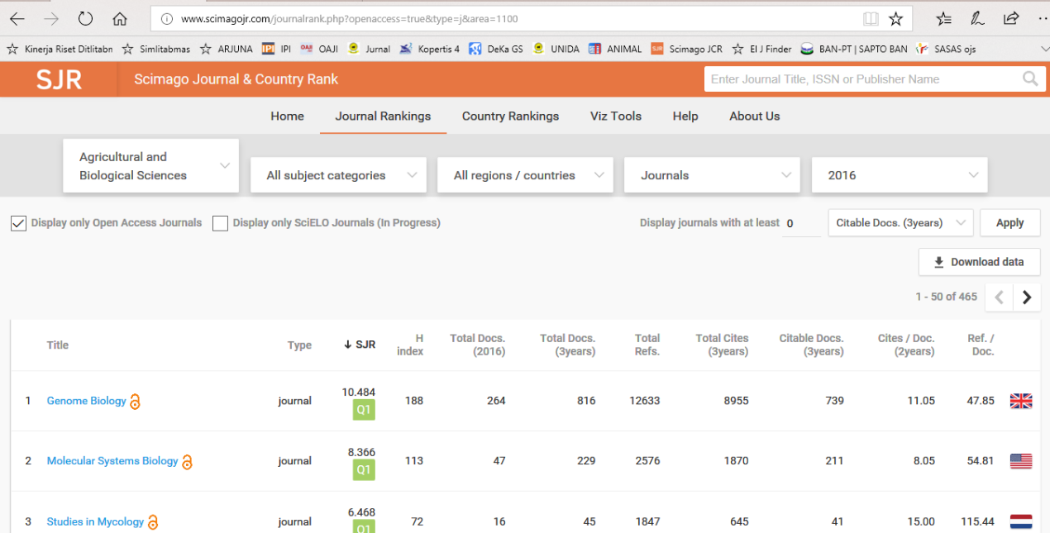

Slide 38
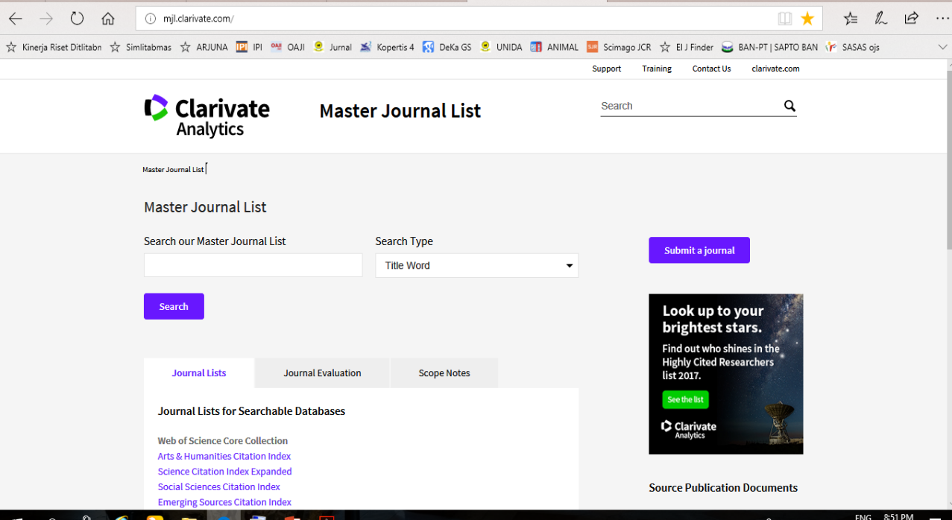

Slide 39
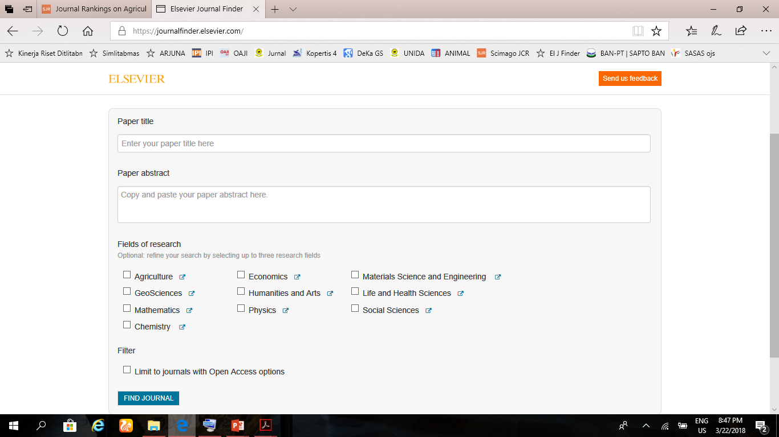

Slide 40


Slide 41
IMPACT FACTOR—THOMPSON REUTERS

Slide 42
CiteScore--SCOPUS

Slide 43
DAFTAR LEMBAGA PENGINDEKS DIPERTANYAKAN

Slide 44
REFFERENCES
TIM PENYUSUN Direktorat Pengelolaan Kekayaan Intelektual Kemenristek Dikti: INTRODUCTION, APPROACHES AND METHODOLOGY, Materi Klinik Penulisan Artikel Ilmiah Internasional Tahun 2017 SOLO, 27-29 September 2017
Elsevier.com/author. 2018. How to publish in scholarly journal?
Elsevier.com/author. 2018. How to get published ?

Slide 45
TERIMA KASIH, SEMOGA BERMANFAAT

